Slide 1
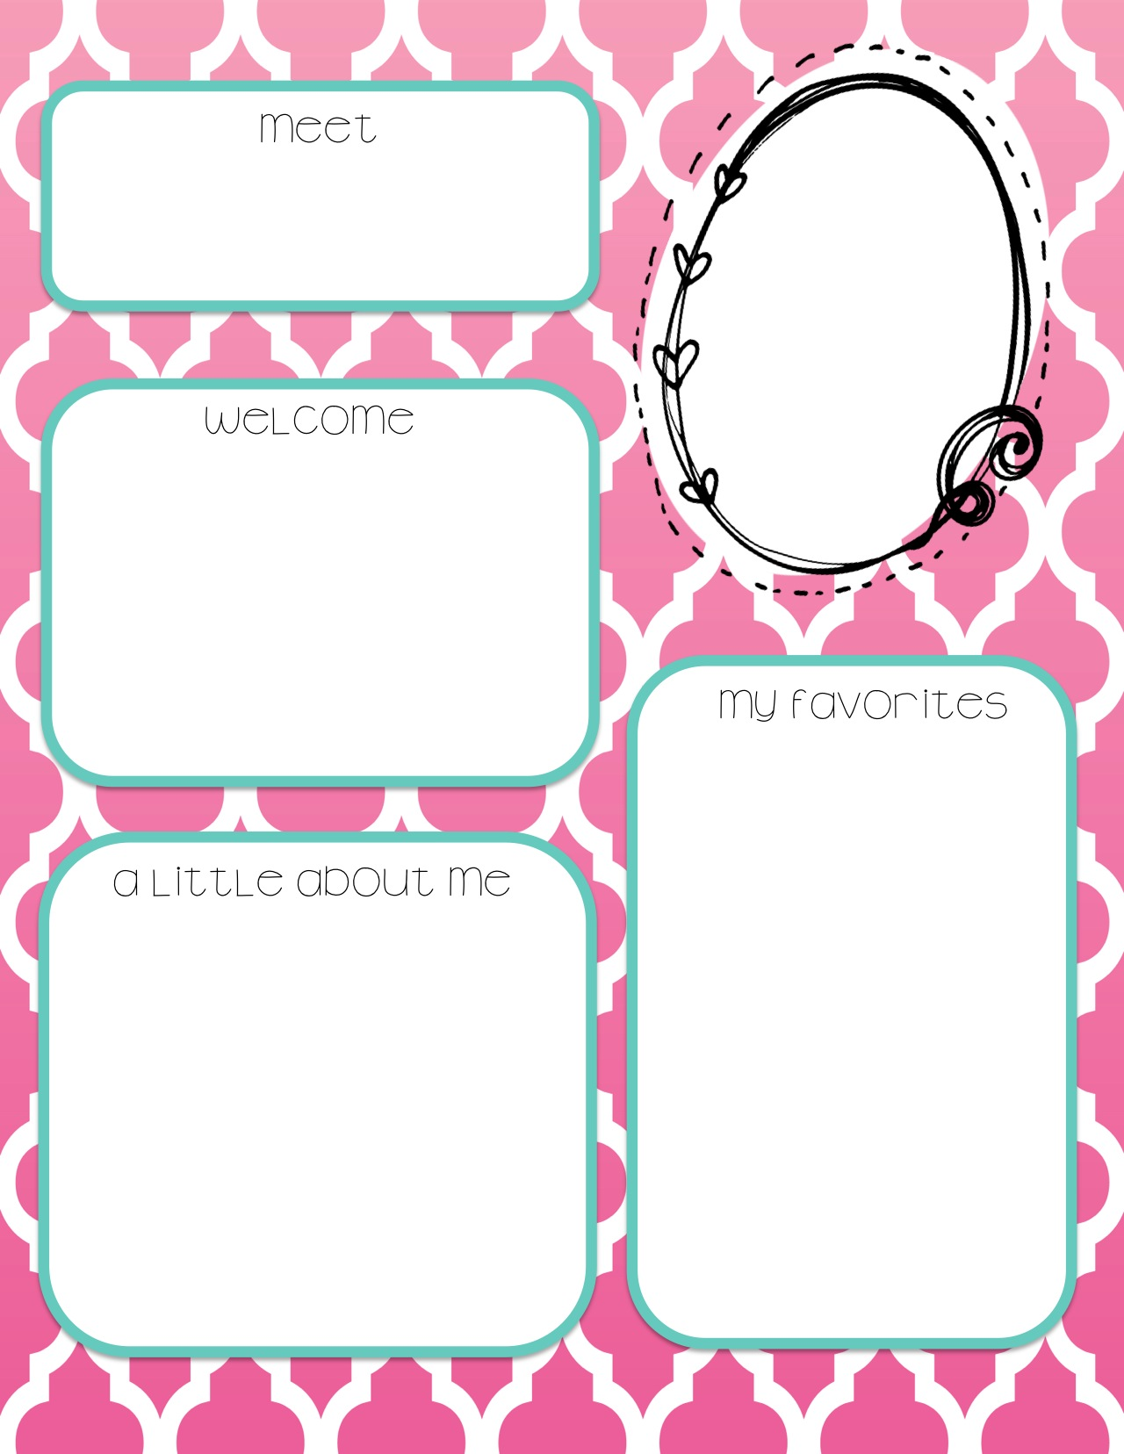
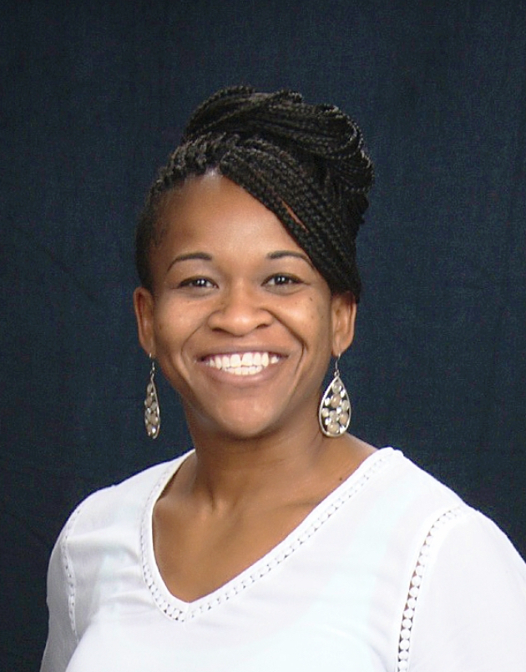
Mrs. Davis
Welcome to Biology! I am truly excited about you being a part of my class. I LOVE teaching and I plan on making your experience with Science as FUN and Exciting as possible.
I am not saying it will be easy. There will be challenges, BUT I am here to ensure success.
WE CAN DO THIS!
School Supplies-Colorful Pens, Colorful-fine tip Sharpies
Color- Brown, Green, Purple
Candy- Kit Kat
Restaurants- Cheddars
Cotton Patch
Fast Food- Chick-Fil- A
Store- Bath and Body Works
Sport-Track and Field
There is no way I can fit everything I want to share with you into this tiny box.
Check out my website for more information about me, my teaching style and ideology.
I was born and raised in Houston, TX. This is my 15th year teaching and my 2nd full year in Mansfield ISD. I have taught Biology, Chemistry, Physics, and IPC.
I have 5 kids of my own. Their ages include 15, 14,8,5, and 3.
Website-adavisscience.weebly.com

