Slide 1
This is Evolution

Slide 2
Change over time is Evolution look at technology Or the clothes that we wear.

Slide 3
Living things go through evolution For example the finches beak It matches the food they eat

Slide 4
(Darwin noticed) on Galapagos The finches share similarities but have different beaks

Slide 5
Over time their beaks changed to accommodate The food sources they ate

Slide 6
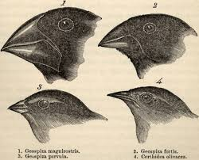
This is Evolution

Slide 7
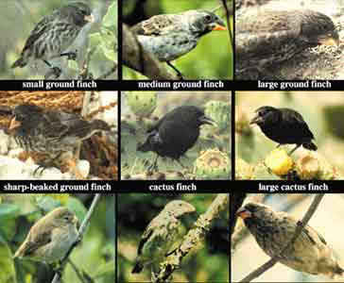
This is Evolution

Slide 8
CHANGES IN POPULATIONS

Slide 9
This is Evolution

Slide 10
Natural selection leads to evolution. Organisms with the better genes Survive and produce offspring

Slide 11
this happens when the environment Influences or selects living things with certain characteristics

Slide 12
Organisms that have traits best suited for conditions of their life and environment

Slide 13
Are more likely to survive and reproduce And pass on their traits This is “survival of the fittest”.

Slide 14
This is Evolution

Slide 15
This is Evolution

Slide 16
CHANGES IN POPULATIONS

Slide 17
This is Evolution

Slide 18
Behavior and structures inherited Are called adaptations. they are caused by mutations.

Slide 19
These genetic variations Are advantageous the survival of the organism

Slide 20
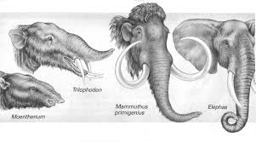
This is Evolution

Slide 21
This is Evolution

Slide 22
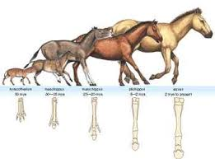
CHANGES IN POPULATIONS

Slide 23
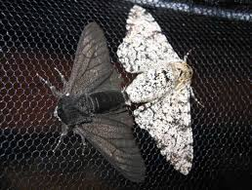
This is Evolution

Slide 24
This is Evolution

Slide 25
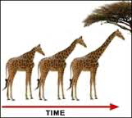
Evolution is change in a species over time

Slide 26
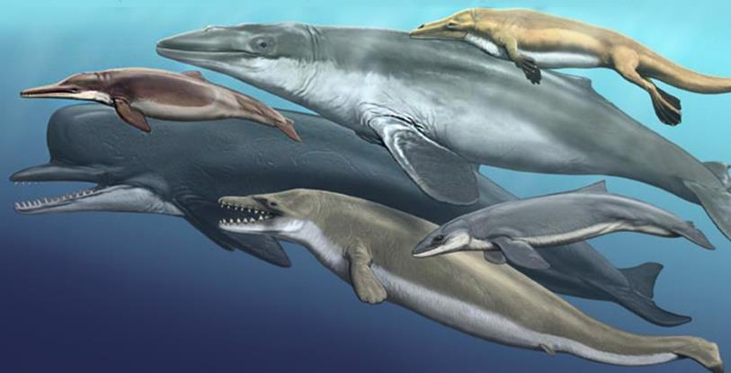
Evolution is change in a species over time

Slide 27
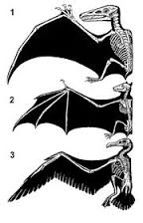
Evolution is change in a species over time

Slide 28
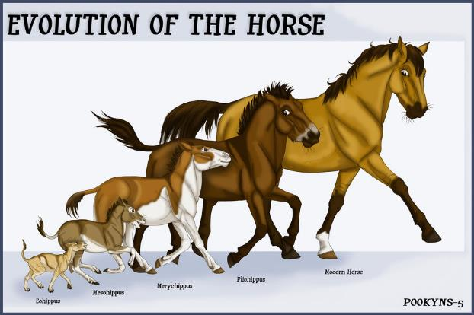
Evolution is change in a species over time

Slide 29
CHANGE OVER TIME IS Evolution

