Slide 1
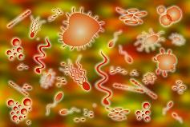
VIRUS FUNK

Slide 2
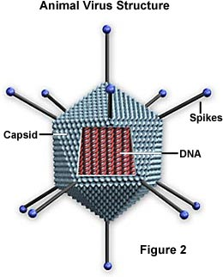
Don’t get, viruses that have capsids, called protein coats

Slide 3
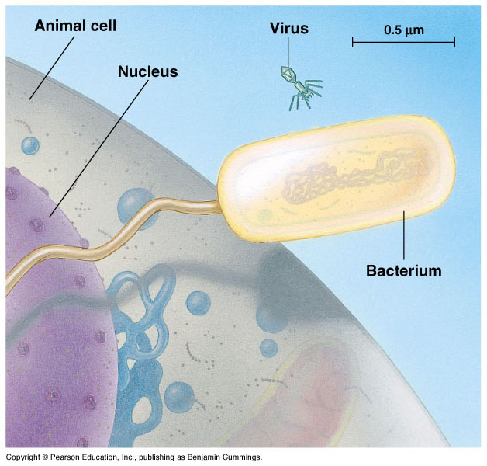
Or contract them particles that destroy cells, they’re microscopic

Slide 4
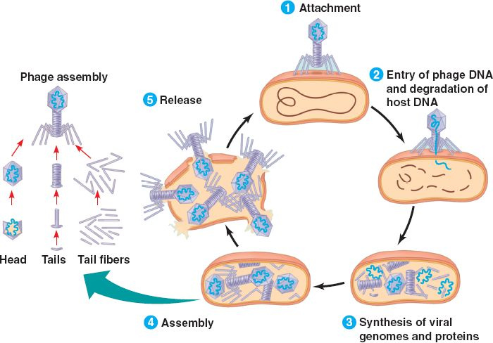
They replicate, destroy, and lyse cells in your body

Slide 5
(Got DNA or RNA) Remind yourself, THEY’RE NOT LIVING)

Slide 6
I feel hot (oh no) Call a nurse or a doctor man I'm getting spots (oh no) can’t treated with antibiotics I'm too hot (oh no) I’m starting to perspire man I'm too hot (oh no) How are viruses spread? break it down

Slide 7
Passed by body fluids (eww) Passed by body fluids (eww) Passed by body fluids (eww)

Slide 8
if you share cups, they’ll get into ya if you kiss BAE, they’ll get into ya 'if you share stuff get into ya

Slide 9
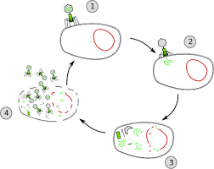
In the body they’ll lyse your cells Don't believe me just watch (come on)

Slide 10
Don’t believe me just watch.

Slide 11
Don’t believe me just watch.

Slide 12
Don’t believe me just watch.

Slide 13
Stop! Wait a minute. I think this virus is Lytic! I felt the symptoms really quick I need the doc to run some test.

Slide 14
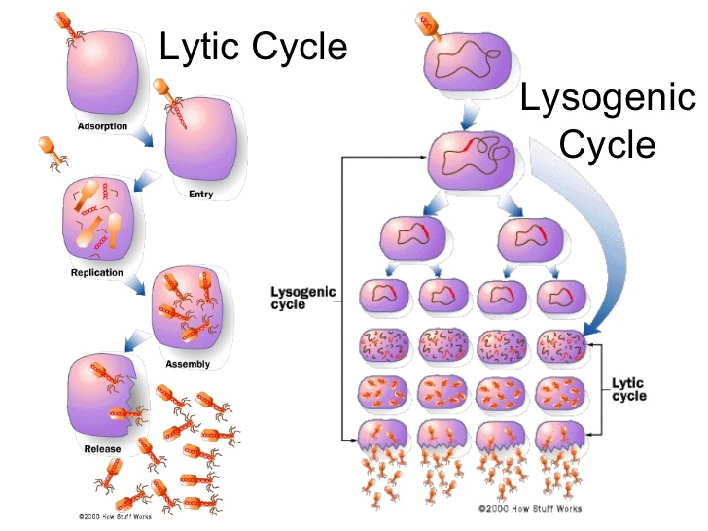
If the virus was lysogenic it wouldn’t burst my cells right away.

Slide 15
It’s DNA becomes part of mine as the cell replicates.

Slide 16
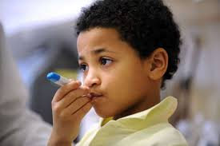
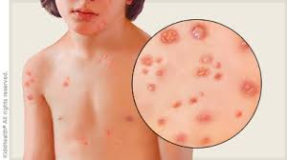
I feel hot (oh no) Call a nurse or a doctor man I'm getting spots (oh no) can’t treated with antibiotics I'm too hot (oh no) I’m starting to perspire man I'm too hot (oh no) How are viruses spread? break it down

Slide 17
Passed by body fluids (eww) Passed by body fluids (eww) Passed by body fluids (eww)

Slide 18
if you share cups, they’ll get into ya if you kiss BAE, they’ll get into ya 'if you share stuff get into ya

Slide 19
In the body they’ll lyse your cells Don't believe me just watch (come on)

Slide 20
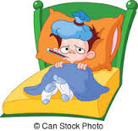
Viruses mess you up They Make you Feel Yuck! Viruses mess you up They Make you Feel Yuck! Viruses mess you up They Make you Feel Yuck! Viruses mess you up They Make you Feel Yuck!

Slide 21
Viruses are NOT LIVING! Their projections are specific to the host they want to get in. The are NOT Living.

Slide 22
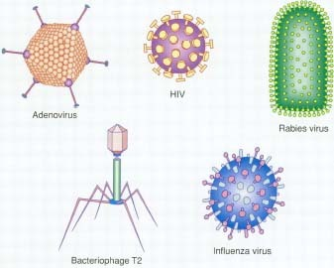
Viruses are NOT LIVING! Their projections are specific…. In your body they’ll LYSE your cells DON’T BELIEVE ME JUST WATCH!

Slide 23
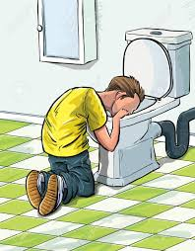
Viruses mess you up They Make you Feel Yuck! Viruses mess you up They Make you Feel Yuck! Viruses mess you up They Make you Feel Yuck! Viruses mess you up They Make you Feel Yuck!

